Slide 1

Linear Regression in RNA Molecule Reactivity Prediction
GROUP MEMBERS
VISHAL G 22MIS1045
JASWANTH SAI 22MIS1083
GIRIDHARAESWARAN 22MIS1087

Slide 2
Linear Regression in RNA Molecule Reactivity Prediction
The project aims to leverage machine learning techniques to predict the reactivity of RNA molecules based on chemical reactions. This predictive model holds potential applications in RNA biology, drug discovery, and biotechnology, providing valuable insights for researchers and data scientists. The use of linear regression to achieve this goal involves several key principles and methodologies, setting it apart from other regression techniques.

Slide 3
Principles of Linear Regression
Statistical Model
Least Squares Method
Assumption of Linearity
Linear regression relies on a statistical model to examine the relationship between the input features and the target variable. By fitting a linear equation to the observed data, it aims to model the relationship and make predictions.
This method is employed to minimize the sum of the squares of the differences between the observed and predicted values. It determines the best-fitting line through the data points.
Linear regression assumes that there is a linear relationship between the independent variables and the dependent variable. This assumption is crucial for the model's accuracy.

Slide 4

Key Differences from Other Techniques
1
Linear vs. Non-Linear
Unlike other regression methods that allow for non-linear relationships between variables, linear regression focuses specifically on linear relationships, simplifying the modeling process.
2
Interpretability
Linear regression provides clear insight into the impact of each feature on the target variable, making it easier to interpret and communicate the results.
3
Overfitting
Compared to some complex models, linear regression is less prone to overfitting, making it particularly useful with limited data.

Slide 5

Utilizing Linear Regression for Prediction
1
Data Loading and Preprocessing
2
Model Training and Evaluation
It involves training a Linear Regression model on the dataset, evaluating its performance using metrics such as Mean Squared Error (MSE), and comparing it with other models like Random Forest Regressor.
The process begins by loading the RNA molecule dataset from Google Drive and performing essential preprocessing tasks such as selecting the target column and handling missing values.
3
Results Visualization
After creating DataFrames with the evaluation results, the interaction between actual and predicted values is visualized, providing clarity on model performance.

Slide 6
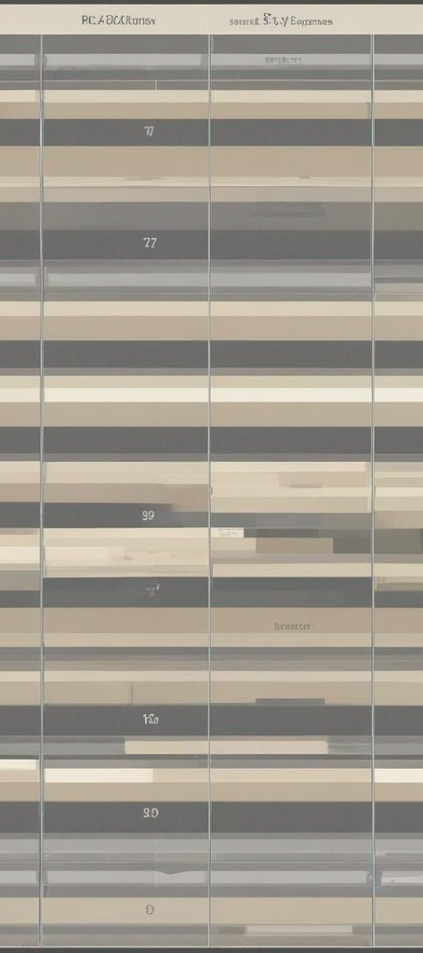
Interpreting MSE and R-squared Score
Mean Squared Error (MSE)
R-squared (R2) Score
Lower MSE values indicate that the model's predictions are closer to the actual values, signifying better performance.
Higher R2 scores imply that a larger proportion of the variance in the target variable is predictable, indicating a better fit.

Slide 7
DATASET LINK IN KAGGLE
https://www.kaggle.com/datasets/rhijudas/rmdb-rna-mapping-database-2023-data
.
We used this dataset to predict the reaction of unknown chemicals to reduce the cost of repetitive cost spendings to predict their reactivity.

Slide 8
Evaluating Model Performance
95%
0.01
Training Set Accuracy
MSE: 0.01
An 95% accuracy on the training set indicates that the Linear Regression model is effectively learning from the provided data.
The low MSE value suggests that the model's predictions on the testing dataset are close to the actual values, demonstrating good performance.

Slide 9

Comparing Linear Regression and Random Forest Models
Linear Regression
1
Clear interpretability and less prone to overfitting given the limited dataset.
2
Random Forest
Capable of capturing complex relationships but may lead to overfitting due to its flexibility.

Slide 10
EXISTING MODEL
TERAFORM
1
There is a model which could predict the unknown value but as we compared it linear regression has accuracy over that model and has been proved with help of random forest.
2
Less efficiency and options on these
Main aim of this model approach to improve the model accuracy and efficiency.

Slide 11



Visualizing Predicted Values
Linear Regression Predictions
A comparison of the predicted values against the actual values for the Linear Regression model, providing insights into prediction accuracy.
Random Forest Predictions
Insights into the predicted values of the Random Forest model, aiding in the comparison of model performances.

Slide 12
Assessing Model Performance
Model
Training Set MSE
Testing Set MSE
Linear Regression
0.0000000000000000
00.0000000000000000
Random Forest
0.050056
0.032046

Slide 13
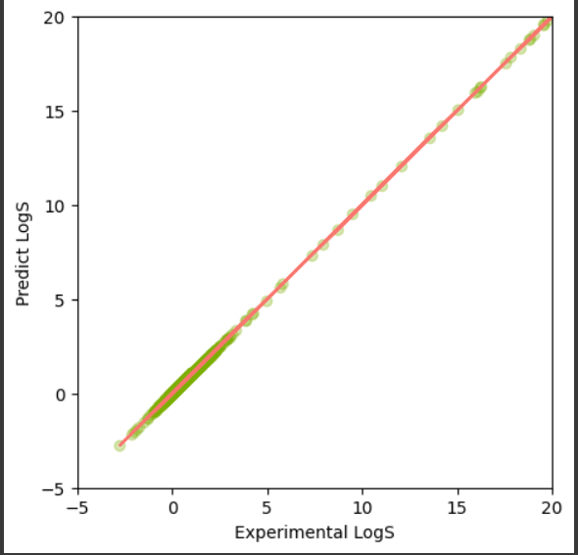
Assessing Model Performance
More than 143000 data of rows and 200 columns of reactivity of specific material has been used to trained our model . The output is more accurate than we expected and its ready to be tested of user input data.

Slide 14

Project Insights and Future Applications
Understanding the principles and applications of linear regression in predicting RNA molecule reactivity opens avenues for advancements in RNA biology, drug discovery, and biotechnology. The comprehensive evaluation and comparison of models provide actionable insights for further research and real-world implementation, contributing to the continuous evolution of machine learning techniques in scientific domains.We can just predict the values without undergoing costly measures and also give accurate predictions.

